Slide 1
Object Detection
Using CNTK Python API
Base Model: AlexNet
Algo: FastR-CNN

Slide 2
POC – Detect Faces in photo Album
This Project is using CNTK 2.2 to train model for multiclass classification of objects in images. Our model can recognize faces by lable connected with picture types we are looking for
What can you find inside:
How to train a multiclass classification for images using CNTK (Cognitive Toolkit) and Faster-RCNN
Training using pretrained AlexNet model
How to prepare and label images in a dataset used for training and testing the model
Working example with all the data and pretrained models

Slide 3

This project was completed using below references and collaboration from MicROsoft Partner vendor and Microsoft research Github repo. All images in PPT except test / train data set & outputs are from web or github listed below https://docs.microsoft.com/en-us/cognitive-toolkit/ https://github.com/karolzak/cntk-hotel-pictures-classificatory/ https://analyticsindiamag.com/r-cnn-vs-fast-r-cnn-vs-faster-r-cnn-a-comparative-guide/

Slide 4
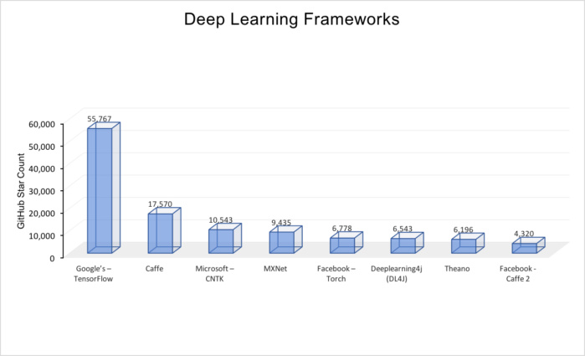
Deep Learning Frameworks to Choose ?
The above figure, Deep Learning Frameworks, summarizes most of the popular opensource deep network repositories in GitHub. The ranking is based on the number of stars awarded by developers in GitHub. The numbers were compiled at the beginning of May of 2017.

Slide 5
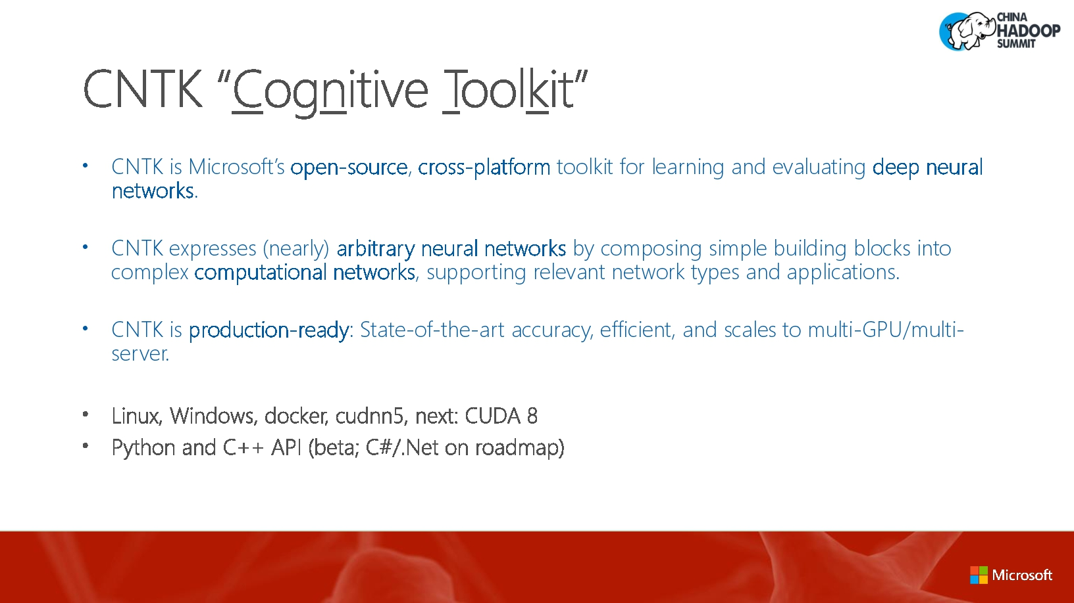
What is CNTK ?

Slide 6
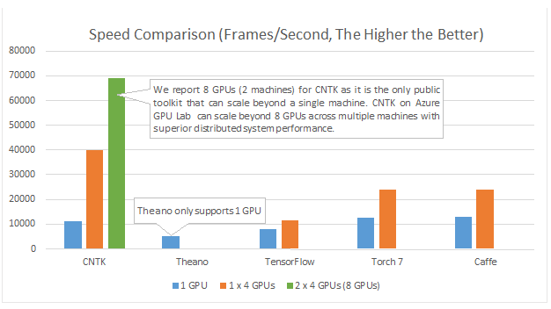
Which platform to choose ?
CNTK can be scaled beyond single machine.
CNTK on Azure has superior distributed system performance

Slide 7
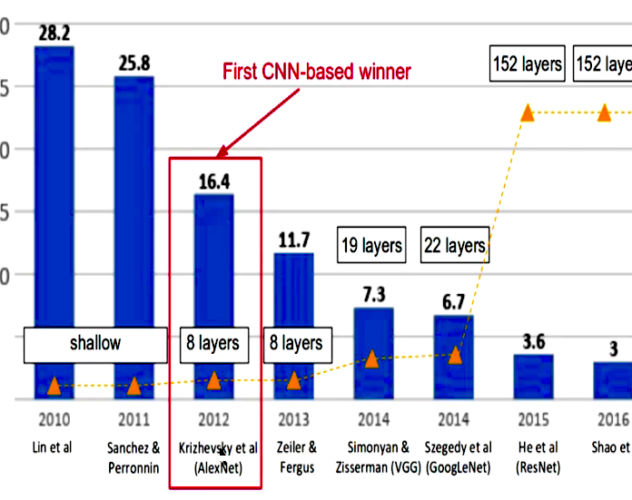
CNN Winners of ImageNet Classification Challenge by Error rate
LeNet (1990s): First Convolutional Neural Network developed.In the years from late 1990s to early 2010s convolutional neural network were in incubation.
AlexNet (2012) – In 2012, Alex Krizhevsky (and others) released AlexNet which was a deeper and much wider version of the LeNet
ZF Net (2013) – The ILSVRC 2013 winner was a Convolutional Network from Matthew Zeiler and Rob Fergus. It became known as the ZFNet (short for Zeiler & Fergus Net). It was an improvement on AlexNet by tweaking the architecture hyperparameters.
GoogLeNet (2014) – The ILSVRC 2014 winner was a Convolutional Network from Szegedy et al. from Google. Its main contribution was the development of an Inception Module that dramatically reduced the number of parameters in the network (4M, compared to AlexNet with 60M).
VGGNet (2014) – The runner-up in ILSVRC 2014 was the network that became known as the VGGNet. Its main contribution was in showing that the depth of the network (number of layers) is a critical component for good performance.
ResNets (2015) – Residual Network developed by Kaiming He (and others) was the winner of ILSVRC 2015. ResNets are currently by far state of the art Convolutional Neural Network models and are the default choice for using ConvNets in practice (as of May 2016).
DenseNet (August 2016) – Recently published by Gao Huang (and others), the Densely Connected Convolutional Network has each layer directly connected to every other layer in a feed-forward fashion. The DenseNet has been shown to obtain significant improvements over previous state-of-the-art architectures on five highly competitive object recognition benchmark tasks. Check out the Torch implementation here.

Slide 8
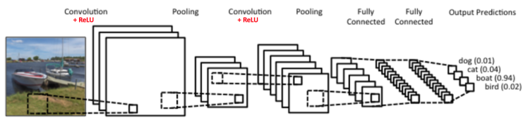
How Does CNN WorKS ?
There are four main operations in the ConvNet shown in Figure
1) Convolution
2) Non-Linearity (ReLU)
3) Pooling or Sub Sampling
4) Classification (Fully Connected Layer)

Slide 9

What is convolution ?
The primary purpose of Convolution is to extract features from the input image by blurring, sharpening, embossing, edge detection. This is accomplished by doing a convolution between a kernel and an image.
We take ‘dot product’ of the convolution filter and the image pixels to get one final value output
Convolution preserves the spatial relationship between pixels by learning image features using small squares of input data.
The 3×3 matrix is called a ‘filter‘ or ‘kernel’ or ‘feature detector’ for 5x5 example image

Slide 10

Effects of convolution with different filters
We can perform operations such as Edge Detection, Sharpen and Blur just by changing the numeric values of our filter matrix before the convolution operation

Slide 11

What is Non-Linearity(Relu)
ReLU is an element wise operation (applied per pixel) and replaces all negative pixel values in the feature map by zero. The purpose of ReLU is to introduce non-linearity in our ConvNet. See figure on left
Other non-linear functions such as tanh or sigmoid can also be used instead of ReLU

Slide 12
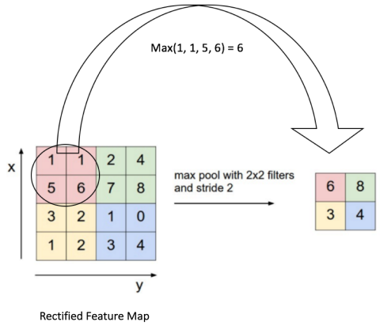
What is pooling?
Spatial Pooling (also called subsampling or down sampling) reduces the dimensionality of each feature map but retains the most important information.
Spatial Pooling can be of different types: Max, Average, Sum etc.
The function of Pooling is to progressively reduce the spatial size of the input representation.

Slide 13
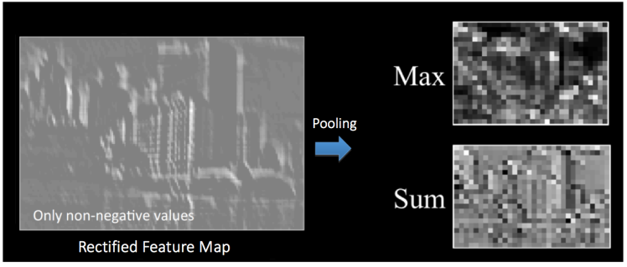
Max or Sum Pooling

Slide 14
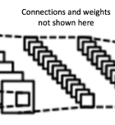
Fully Connected Layer
The Fully Connected layer is a traditional Multi Layer Perceptron that uses a softmax activation function in the output layer.
The output from the convolutional and pooling layers represent high-level features of the input image. The purpose of the Fully Connected layer is to use these features for classifying the input image into various classes based on the training dataset.

Slide 15
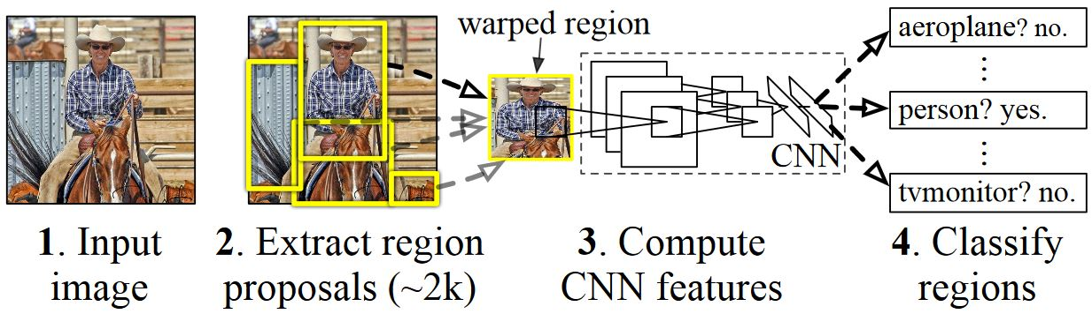
Basic Idea Behind R-CNN Algorithm
Given an input image
A large number region proposals (ROI)are generated.
These region proposals, or Regions-of-Interests (ROIs), are then each independently sent through the network which outputs a vector of e.g. 4096 floating point values for each ROI.
A classifier is learned which takes the 4096 float ROI representation as input and outputs a label and confidence to each ROI.

Slide 16
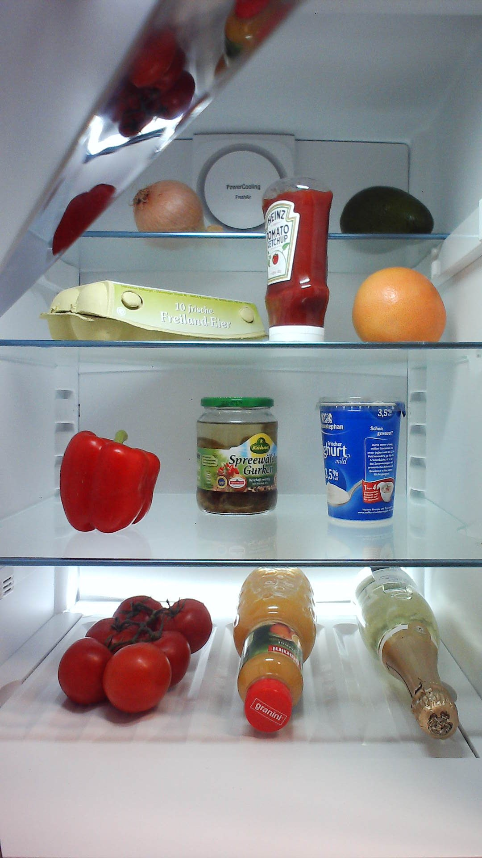
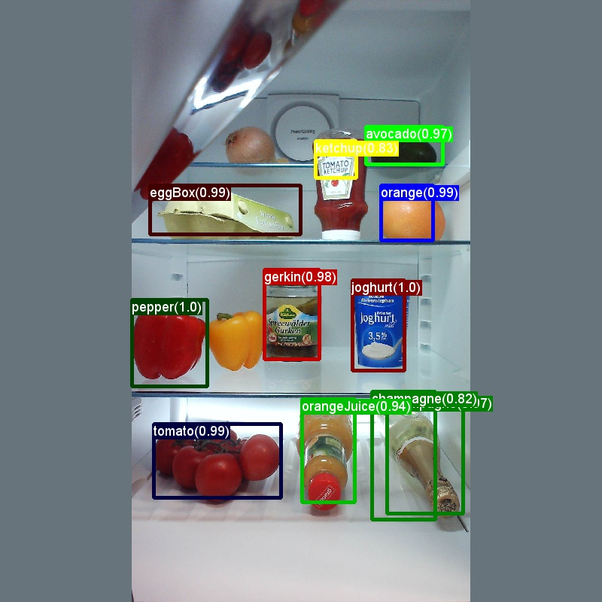
Classic Toy Example for object detection
Input Image
Output Image

Slide 17
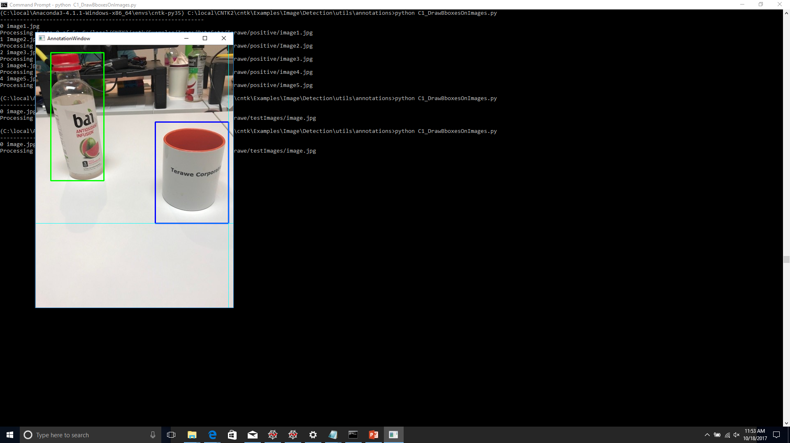
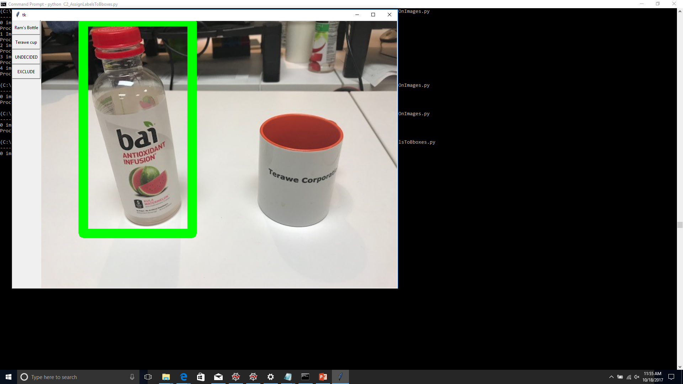
Adding boxes for ROI
Adding Labels

Slide 18
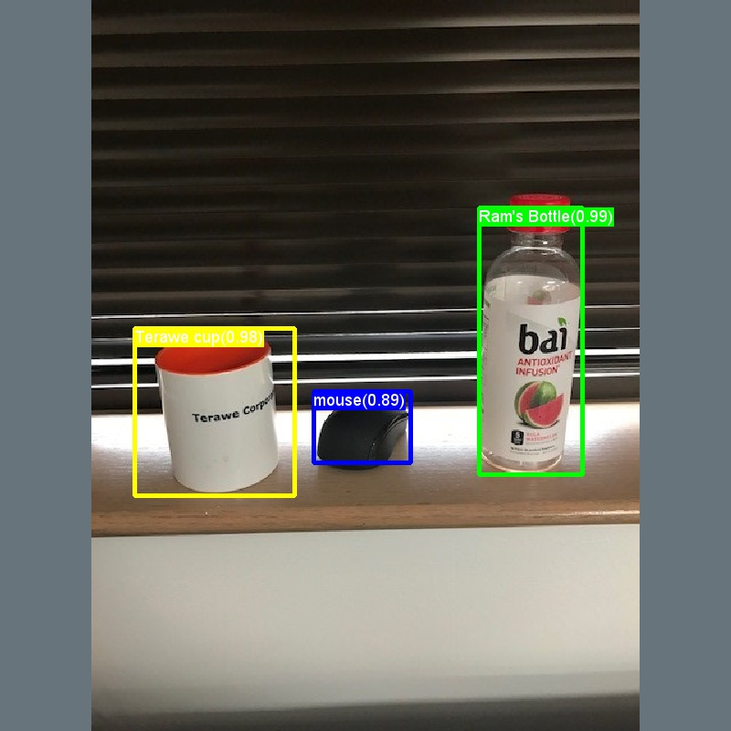
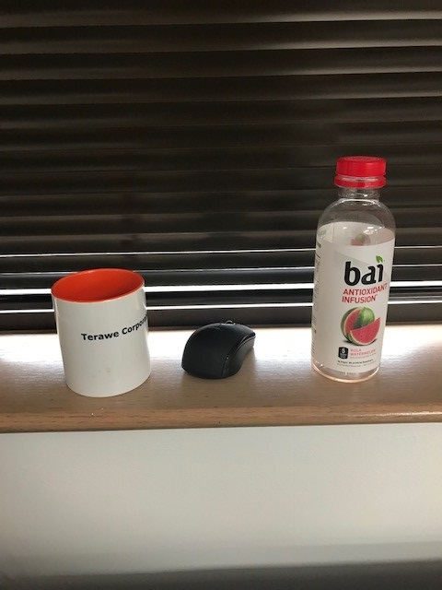
My Experiment
Input Image
Output Labeled Image

Slide 19
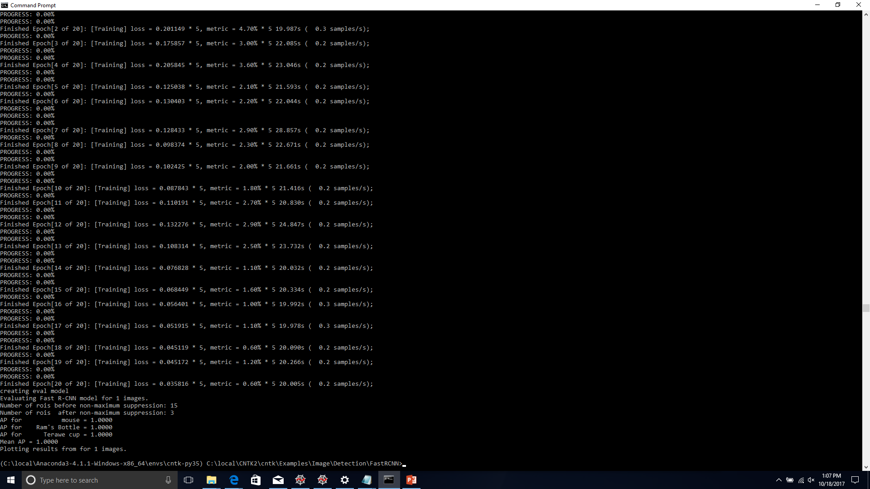
Output after running the main script

Slide 20

What’s Next ?
POC – Detect Faces in photo Album using Fast-RCNN and Faster-RCNN

Slide 21
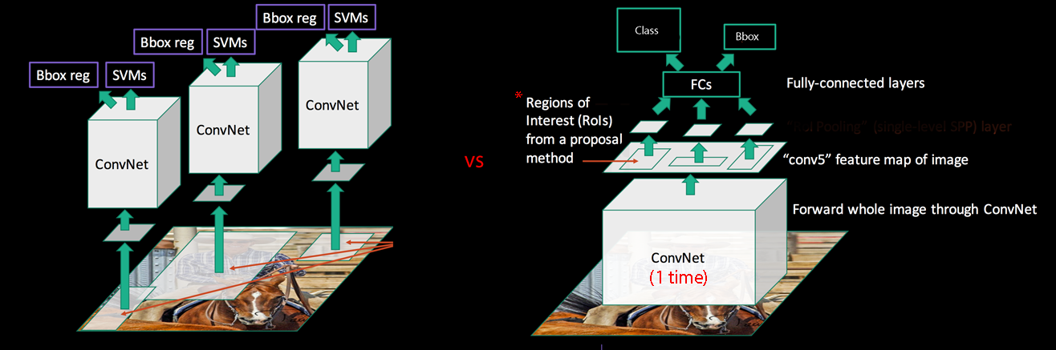
Compare R-CNN versus Fast R-CNN

Slide 22
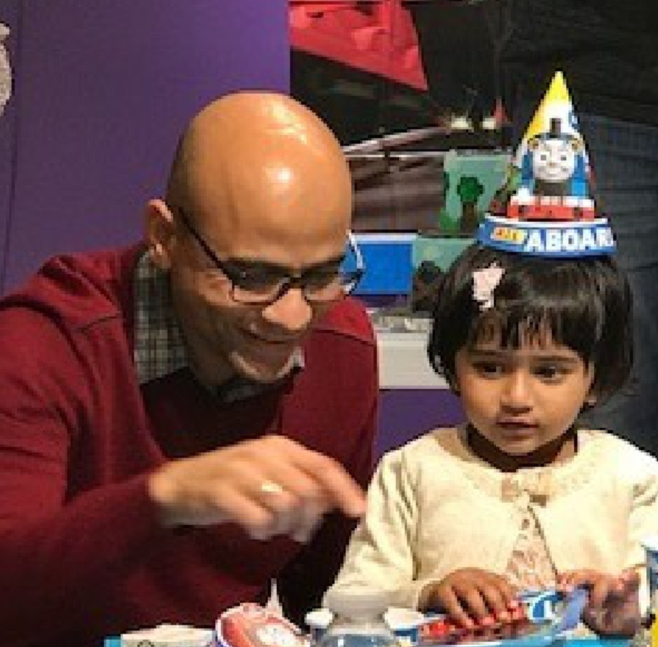
Data Set
We wanted to be as close as possible to real world scenario so our dataset consists of real pictures from family birthday event. In our POC we used images scaled to max of 1000px on the wide side
Every picture usually consists of multiple types of objects we are looking for
We used total of 50 images to train and test our model from which we used:
23 images in positive set for training the model.
11 images in negative set for training the model. Those images should not contain any objects that we are interested in detecting
29 images in test Images set for testing and evaluating the model.

Slide 23
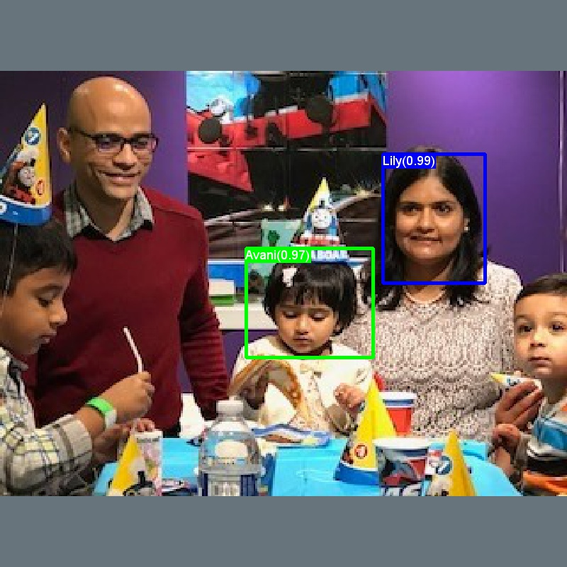
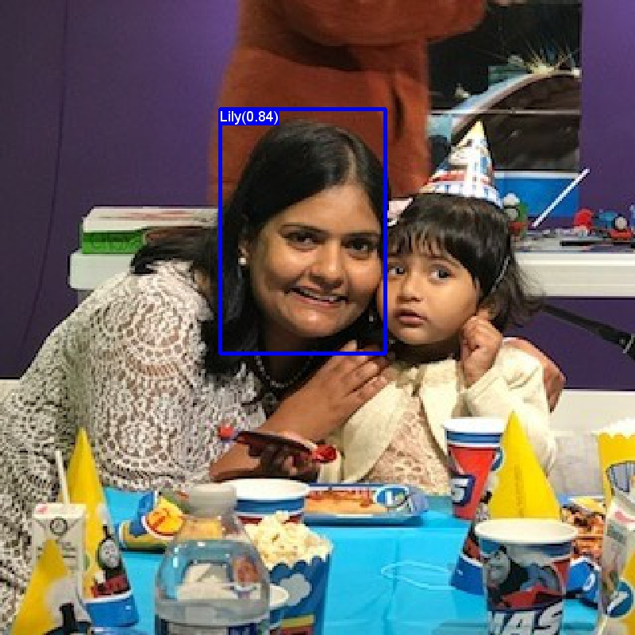
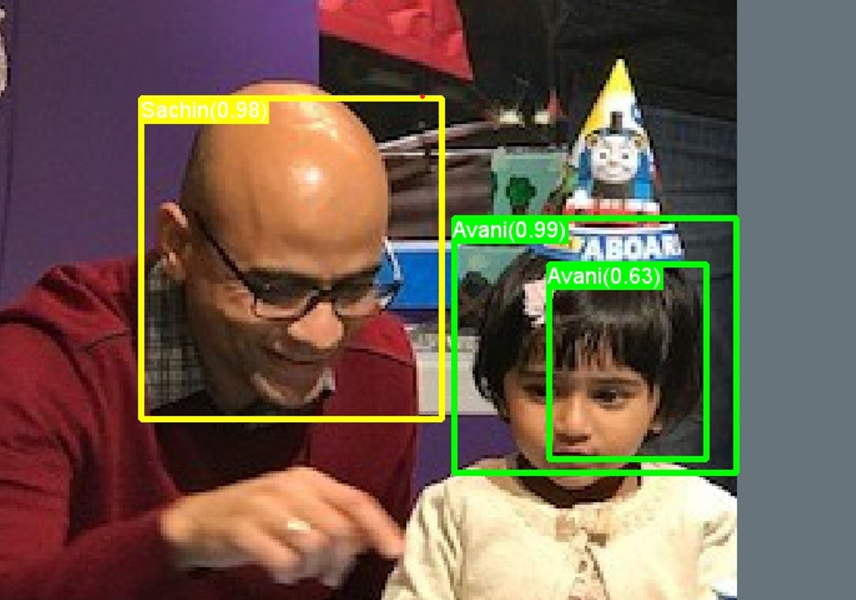
Final Output Using Faster RCNN

Slide 24

Thank you!

